Slide 1
Project Proposal
Team: Wenhui Liu, Zhe Zhang

Slide 2
Purpose of the Project
The purpose of this project is to promote and develop the Gomoku culture, so that more people can feel the charm of Gomoku and find the fun in it. Gomoku can enhance thinking ability and improve intelligence. It has the characteristics of being simple and easy to learn, popular among the people, as well as profound skills and high-level international competitions. It is a point of exchange between Chinese and Western cultures and the crystallization of ancient and modern philosophy.

Slide 3

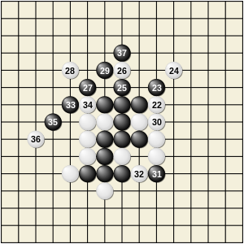
Game Image

Slide 4
What is the problem you aim to tackle with your project?
The main purpose of our project is to provide people with more ways to entertain themselves and to enhance the friendship and communication between people.

Slide 5
Why is this problem important to tackle?
In the busy work and study life at ordinary times, appropriate games can bring people happiness and relaxation. Because our project is a two-player game, the friendship between friends has been greatly enhanced in the communication process of the game.

Slide 6
Who stands to benefit from this app most?
Because our project is a simple puzzle game, it's easy to learn, so it benefits everyone.

Slide 7
List other apps that have addressed the same problem
Chess, card games
For each app you listed above, list in what ways it is lacking
Chess: high difficulty for beginners
Card Games: there are many rules to remember

Slide 8
For each shortcoming you have identified above, state whether you intend to address it, and (briefly) how
In our app, we let users play a simple game. There are no complicated rules and it's easy for beginners to get started.

Slide 9
List any technologies you are considering for your project; compare them to alternative options, and state which one(s) you find more promising and why
Consider providing man-machine battle, which requires an algorithm to achieve.
Join the Internet battle to achieve the situation of playing the game without face to face, which requires an algorithm and Android Studio Internet Permission, etc.

Slide 10
Thank You!

